Slide 1
Позитроний:
Фундаментальные и Прикладные Исследования
С.Н. Гниненко
ИЯИ РАН
ИЯИ РАН , Троицк
15 Февраля 2011

Slide 2
В соавторстве с
М.В. Акопян
Г.С. Атоян
А.С. Белов
Н.А. Голубев
М.И. Добролюбов
А.Ю. Игнатьев
М.М. Кирсанов
Ю.М. Клубаков
Н.В. Красников
В.А. Матвеев
А.А. Поблагуев
В.Е. Постоев
В.И. Разин
Ю.В. Рябов
В.Д. Самойленко
В. Сухов
В.А. Рубаков
Д.С. Горбунов
С.В. Дубовский
N. Alberola
T. Antonius
A. Badertscher
C. Bath
P. Crivelli
N. Djourelov
U. Gendotti
R. Foot
P. Nedelec
A. Rubbia
D. Sillou

Slide 3
ПЛАН
Введение
Поиск новой физики в распадах позитрония
Разработка новой экспериментальной техники:
пульсирующий пучок медленных позитронов и
временной спектрометр на электронах вторичной
эмиссии
Эксперимент по измерению свободного
гравитационного падения антиводорода
Дефектоскопия наноструктурных материалов
Заключение

Slide 4
High and Low energy approaches to Search for New Physics
SM is not a complete theory, many q`s: what is the origin of masses? how massive are neutrinos? where is and what is dark matter? … why parity is violated?
High energy physics -Probe unknown physics in direct
way in high energy collisions of particles:
new scale Λ_{NP}~E>>m, probe of short distances,
resolution : r~hc/∆q ~1/E ~10⁻¹⁷cm/E(TeV)
Low energy physics - New results could be expected
from precision measurements at low energies: ∆q < m
Large distances and large amount of space
involved in the interaction.
Typically precision requied ~ (m/Λ_{NP} )^{n}

Slide 5
New Physics: high-energy vs low-energy experiments
Н.В. Красников, В.А. Матвеев
“Новая Физика на Большом
Адронном Колайдере“ (2010).
Higgs
SUSY
Extra Dimensions
Hidden valley
…………….
H-H’ , Ps-Ps’ mixing
g-2, mu-e, …
Newton low, Ps->invisible
Ps -> invisible (vacuum)
…………….

Slide 6
Introduction to Positronium
Positronium (Ps) is the bound state of an e+ and e-
An atom without a nucleus (no Strong Interaction)
No nuclear structrure effects on atomic spectrum
(Nuclear charge, magnetization distributions, sructure functions)
Weak Interaction effects: Really, really small!
Z exchange: opposite parity levels mix at 10⁻⁽¹⁰⁻¹¹⁾
A purely leptonic system described entirely by QED (almost)
Extremely rich in symmetries
States ψ(1,x) are ³S₁ = Orthopositronium (o-Ps) mean lifetime ~ 140 ns
State ψ(0,0) is ¹S₀ = Parapositronium (p-Ps) mean lifetime ~ 125 ps
³S₁ (o-Ps) cannot decay to two photons --
angular momentum of photons
Wheeler, Ann. N.Y. Acad. Sci. 48, 219 (1946).
P symmetry requires ¹S₀ two photon decay to have
photons w/perpendicular lin.
polarization, Yang, Phys. Rev. 77, 242 (1950).

Slide 7
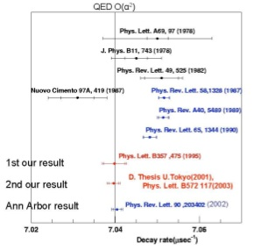
o-Ps decay rate puzzle
Review: Dobroliubov, Gninenko, Ignatiev, Matveev, IJMP А8 (1993) 2859
Discrepancy :
new unknow contribution
Br(oPs->X)~10⁻³
experimental problems
B is anomalously big
Ann Arbor “big” cavity
Tokyo measurements
(oPs formation in target)
Ann Arbor experiment
(oPs formation in vacuum,)
agree to each other and also agree with QED predictions
Ann Arbor “small” cavity
Today: agreement within 1sigma, but theoretical accuracy is a factor 100 better!

Slide 8
Поиск новой физики
в распадах позитрония

Slide 9
Что можно искать в экспериментах с Ps?
Proceedings, International Workshop, Zurich, Switzerland, May 30-31, 2003.
M. Felcini, (ed.), S.N. Gninenko, (ed.), A. Nyffeler, (ed.), A. Rubbia, (ed.) (Zurich, ETH & Moscow, INR) . 2004. 217pp. Published in Int. J. Mod. Phys. A19 (2004) 3769-3985
Recent review: S.G., Krasnikov, Matveev, Rubbia, Phys.Part.Nucl. 37(2006)
новые частицы
новые силы или взаимодействия
новые законы сохранения
Topics:
Search for exotic decays: gamma +X( axions, light bosons, taxions, …)
Search for C violating modes of decay to 4, 5 photons
Lorentz violation search
Search for CP violation in o-Ps decay
Search for CPT violation in o-Ps decay
Search for “Invisible Decay” (missing energy) -- new result + plans
Motivation for o-Ps invisible decay experiment
Previous experiments on invisible decays of o-Ps

Slide 10
Positronium decays in the standard model
parapositronium g.s.: L=0, S=0, pPs-> 2, 4, .. γ,
τ~10⁻¹⁰ s
orthopositronium g.s.: L=0, S=1, oPs-> 3, 5, .. γ,
τ~10⁻⁷ s
oPs-->2γ forbidden
Br (pPs-->4γ)~ Br(oPs-->5γ)~10⁻⁶
e⁺ + e⁻ + M -> γ + M or e⁺ + e⁻ + M -> M* are small
Br(oPs--> invisible)<~10⁻¹⁸ is extremely small
Important Conclusion:
only 0, 1, 2 , 3 , 4 , ..gamma in the final state.
for Br(oPs--> anything)>~10⁻⁵

Slide 11
Bounds on rare o-Ps decay modes
Decay mode Upper limit, ppm (90%C.L.) Comments Group
Axion, Long-lived X boson
5-1 m_{X}~~100-800 keV CERN
c+X 1.1 m_{X}< 800 keV Tokyo U.
340 m_{X}< 30 keV INR Moscow
Short-lived X boson
c+X -> c + 2 c 300 m_{X}< 500 keV Tokyo U.
28 m_{X}< 100 keV INR Moscow
2 c 350 Space Tokyo U.
230 isotropy Michigan U.
4 c 2.6 C-parity Tokyo U.
3.8 violation Berkeley
c+X +Y 44 m_{X} + m_{Y}< 900 keV ETH-INR Moscow
540 INR Moscow
invisible 2.6 ED, Dark mater, mQ Tokyo U.
0.47 ETH-INR Moscow

Slide 12
Multi-Photon Branching Ratio Results
(O-Ps -> 4γ)/(O-Ps -> 3γ) < 3.7 x 10⁻⁶ (90% C.L.)
Previous limit (1996) < 2.6 x 10⁻⁶ (90% C.L.)
[Yang et al., Phys. Rev. A 54, 1952 (1996)]
(P-Ps -> 5γ)/(P-Ps -> 2γ) < 2.7 x 10⁻⁷ (90% C.L.)
(no previous limit)
C Symmetry Tests
(90% Confidence level limits)
(O-Ps -> 5γ)/(O-Ps -> 3γ) = 1.67(99)(37) x 10⁻⁶
QED value(tree) = 0.9591 x 10⁻⁶
Previous mmt.(1 event, ‘95) = 2.2(2.2) x 10⁻⁶
[Matsumoto et al., Phys. Rev. A 54, 1947(1996)]
(P-Ps -> 4γ)/(O-Ps -> 2γ) = 1.14(33)(21) x 10⁻⁶
QED value(one-loop) = 1.4388 x 10⁻⁶
Previous mmt. (1994) = 1.50(11) x 10⁻⁶
[von Busch et al., Phys. Lett. B 325, 300 (1994)]
QED Tests (1 σ errors)

Slide 13

Time Reversal Symmetry in o-Ps Decay
{C, P, T, CP, CPT and positronium
Krasnikov, IJMP, A19,2004}
In the decay (o-Ps -> 3γ), the photon momenta all lie in a plane.
Decay plane normal vector , where 1 and 2 are the highest energy photons.
decays to
Polarized ³S₁ positronium
T
photon momenta and spin reverse
does not reverse.
decays to
³S₁ positronium
is a T-odd observable.
o-Ps is CP even, so is CPT- odd
*(caveat)

Slide 14
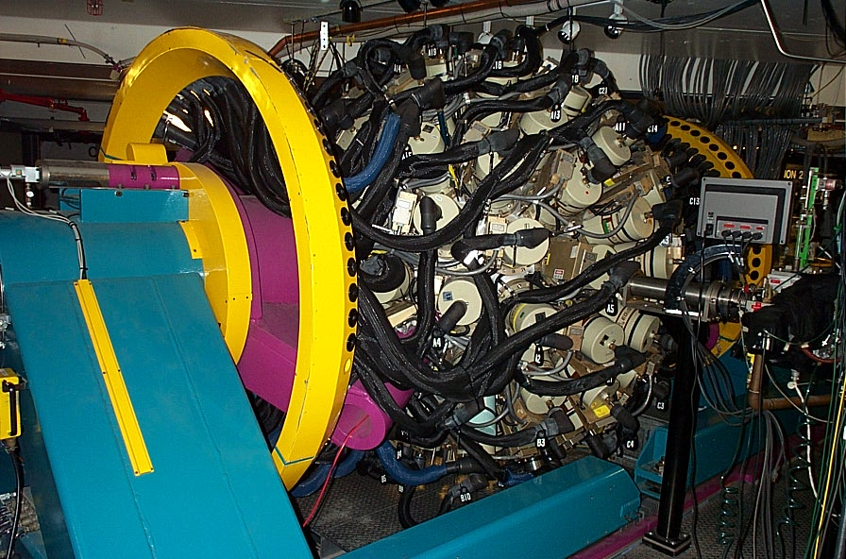
The Gammasphere Detector Array -- LBNL/ANL
110 High-Purity Germanium detectors

Slide 15
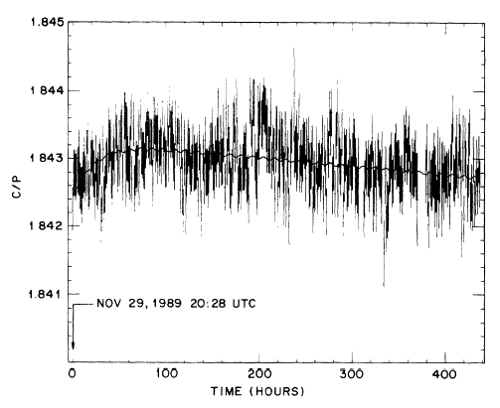
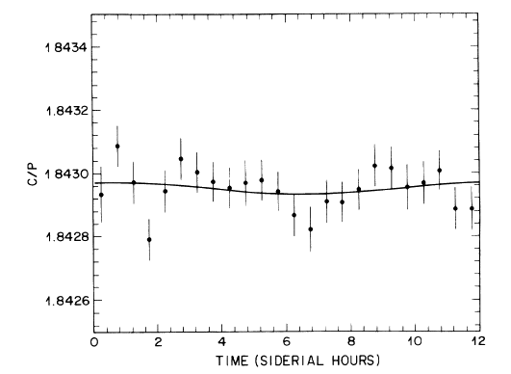
Lorentz Violation
“Search for Spatial Anisotropy in Orthopositronium Annihilation,”
A.P. Mills and D.M. Zuckerman, PRL 64, 2637 (1989)
Effectively a search for (o-Ps -> 2γ)
(not allowed in naive non-commuting QED...)
Magnetic field quences m = 0 state of o-Ps
Lorentz violation would quench m = +/-1
Time dependence Ω (12 h)
Measure 3γ/2γ yield
Ω_{earth}
B
NaI
Ps source

Slide 16
Search for Invisible Decay of Orthopositronium
Motivations
What is the mechanism by which e⁺e⁻ annihilates to an invisible final state?
1. Mirror matter
e⁺ + e⁻ → γ (virtual) → γ∗ (mirror analog) = invisible
o-Ps should be formed and decay in vacuum . Br(o-Ps ->nothing) ~ below BBN limit (~1e-6)
Is Interesting
2. Millicharged particles
Could generate (o-Ps → nothing) anywhere from 1e-7 and lower…
Strongly motivated by the PVLAS-CAST discrepancy
3. Neutrino magnetic moment
e⁺ + e⁻ → ν ν ,
Could result in 1e-8 - 1e -10
4. Infinite extra dimensions (RS2)
Could be 1e-8 and lower .
5. Light X-boson
e⁺ + e⁻ → XX, e.g. from g-2 (S.G., Krasnikov, PLB (2001))
6. Standard Model background
e⁺ + e⁻ → ν ν
Branching ratio is about 1e-18, depending on neutrino mass.
7. Unparticles ( H. Georgi (2007))
8. ………………

Slide 17
Extra dimensions models
among GUT, technicolor, SUSY , string, Little Higgs..
models .. Extra Dimensions models probably are the most intriguing. First proposal for ED: Kaluza and Klein in 1920 unification of gravity and e-m in 5D theory
Modern ED theories(>3D) has shifted towards ``brane world'' picture, which assumes that ordinary matter (with possible exceptions of gravitons) is trapped to a 3D submanifold --- brane --- embedded in fundamental multi-dimensional space. In the brane world scenario, ED may be large, infinite, warped; they may have effects, directly observable in current or fothcoming experiments.

Slide 18
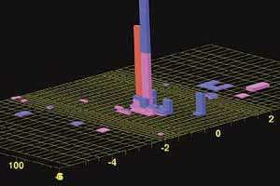
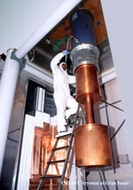
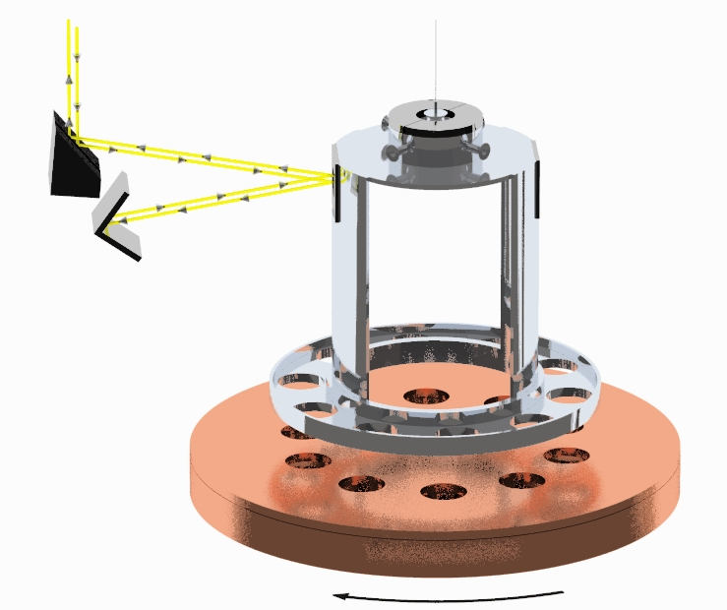
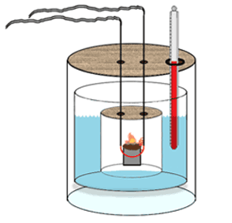
How might extra dimensions be detected?
Discover massive KK modes at particle accelerators
heavy bosons (new particle signature)
heavy gravitons (missing energy signature)
(Substantial Std. Model background)
Maybe the KK modes are stable particles and are dark matter
dark matter, WIMP searches
Gravity behaves differently at short range
fancy Cavendish balances
Mass-energy itself is unstable in some scenarios
bulk modes of particles allow tunneling off our brane
Total calorimetry experiment to search for energy disappearance

Slide 19
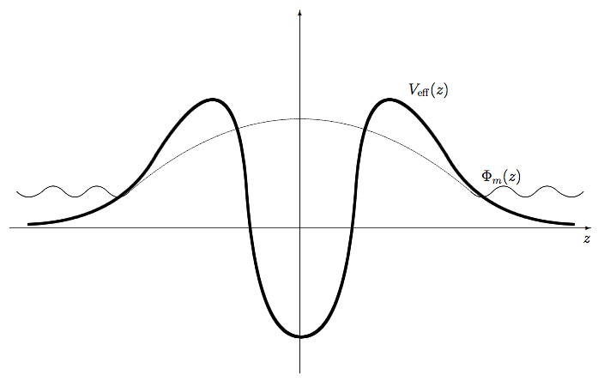
Disappearing massive matter
Literature-
V.A. Rubakov: Physics of extra dimensions, Lectures at CERN, Feb 2004
V.A. Rubakov et al., PRD 62(2000)105011; JHEP 08(2000)041;
Phys.Usp. 44(2001)871.
Dubovsky , Rubakov, Tinaykov PRD 62, 105011;
Rubakov UFN 171(2001) 913-938
“Our world is a brane embedded into a higher-
dimensional space-time.Particles initially located
on our brane may leave the brane and tunnel
into extra dimensions. These transitions have been
found to be generic in a class of models of
localization of particles on a brane”.
N.Arkani-Hamed et al., PLB 429(1998)263; Phys.Today, Febr.(2002)36.
S.Dubovsky JHEP,01(2002)012.
“The presence and properties of the extra dimensions will be investigated
by looking for any loss of energy from our 3D-brane into the bulk”

Slide 20
Tunneling to Extra Dimensions
Mass-energy initially located at our brane is unstable in some scenarios. Particles allow tunneling off our brane and escaping to ED
Experimental signature:
disappearance of a particle
in our world , i.e.
particle → invisible decay
Z
2D-SETUP
Recall:
Properties of Z-->invisible decay plays fundamental role in determination of lepton families number in the Standard Model

Slide 21
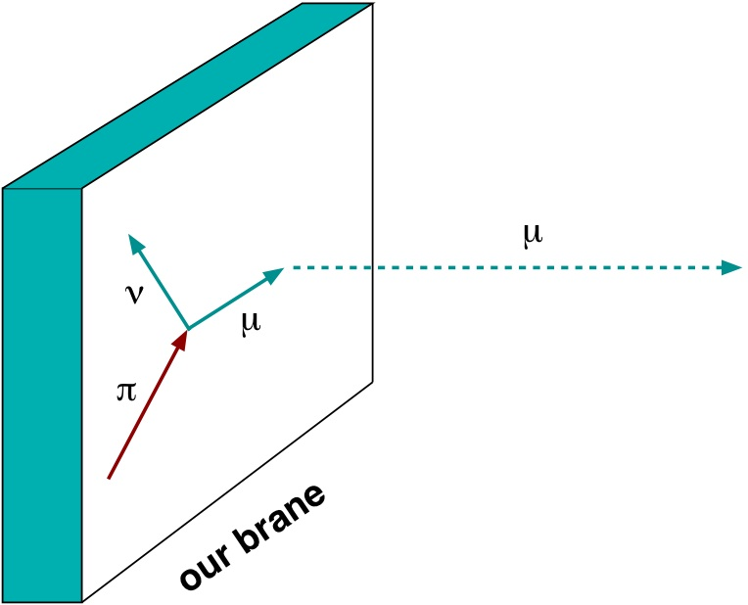
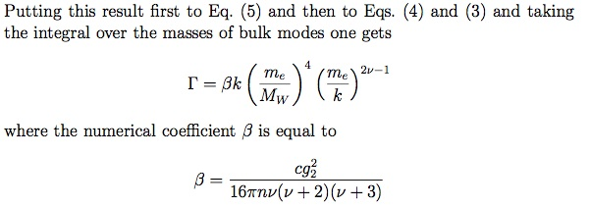
Motivation to search for µ⁺-->invisible
Is the electric charge conserved in brane world?
S.L. Dubovsky, V.A. Rubakov, P.G. Tinyakov JHEP 0008:041,2000.
S.G. , Phys.Rev. D 76, 055004 (2007)
charged lepton escaping rate from
the brane- strong mass dependence.
Too many paramters to make even
an order-of-magnitude prediction
Some generic property of a class of models with large ED may lead to low energy effects:
Electric charge is not conserved in our brane (even for m_{γ}=0 !), but conserved in multi-D space
S.L. Dubovsky`05

Slide 22
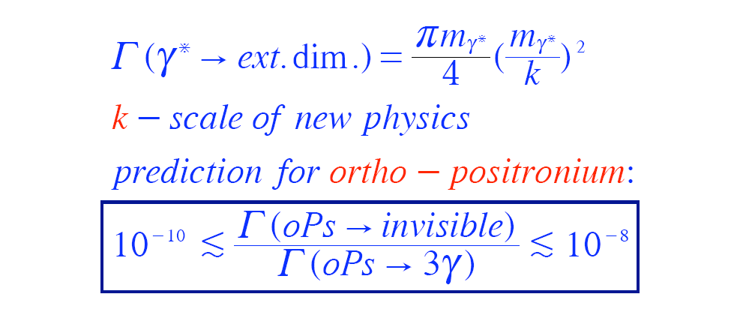
What size signal from oPs escape to extra dimensions ?
SG, Krasnikov, Rubbia Phys. Rev. D 67, 075012 (2003).
Positronium physics.Int. Workshop, ETH, May 30, 2003, Int. J. Mod. Phys. A19(2004)
Escaping rate of oPs
( for n=2 extra dimensions)
BULK
Our brane
e+
γ
γ
e-
In the SM oPs-> inv rate is very small:

Slide 23
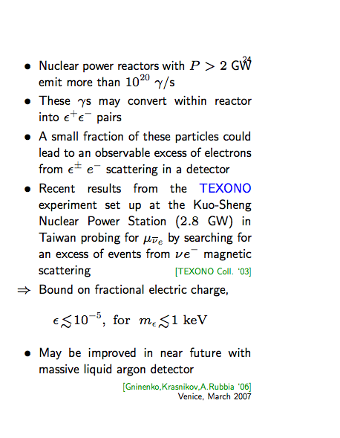
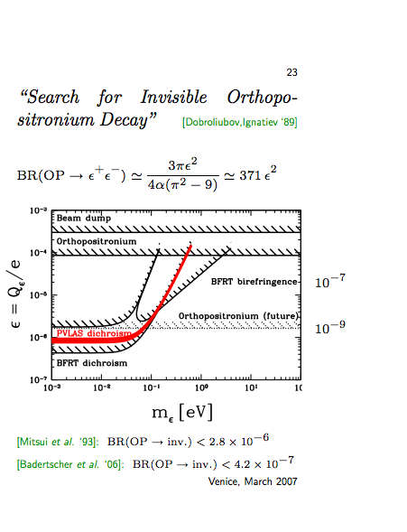
Direct Tests of mQ`s
Search for mQ`s in Reactor Experiments
Gninenko `89
PRD,2007

Slide 24
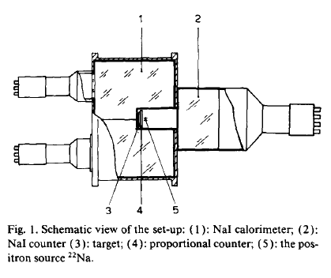
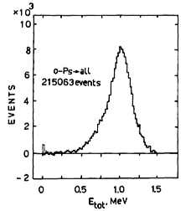
INR group: first experiment on o-Ps->nothing
“A search for photonless annihilation of orthopositronium,”
Atoyan, Gninenko, Razin, Ryabov , Phys. Lett. B 220, 317 (1989).
Motivated by : LEP1 Z->invisible , and mostly by Dobroliubov, Ignatiev, Matveev: π-> 2 photino,
Sov.J.Nucl.Phys.47:296,1988, Yad.Fiz.47:468,1988.
Radioisotope Ps source (²²Na)
Generate trigger on ²²Na decay
(positron + 1.2 MeV photon)
Detect energy of all e+ annihilations
Subtract p-Ps -> 2γ events in NaI spectrum
“Difference of two large numbers” problem
Statistics, background limited
e+ tag
Cannot be resnonsible for
o-Ps decay rate anomaly.
o-Ps->nothing
signal

Slide 25
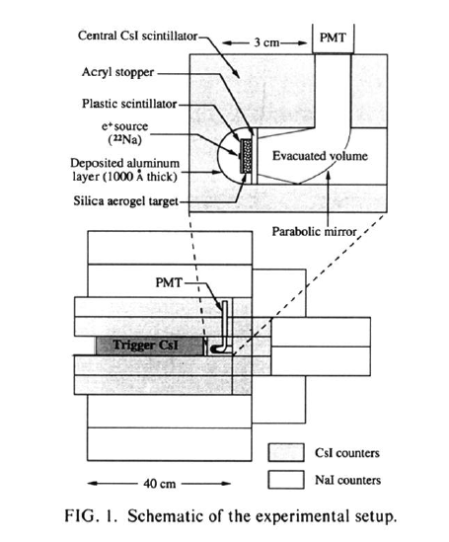
Tokyo experiment on o-Ps -> nothing
Radioisotope source: 22Na
Composite trigger: (e+) & (1275 keV)
840 kg calorimeter mass
“High resolution” 1275 keV trigger
Statistics, PMT noise limited
T. Mitsui et al., PRL 70, 2265 (1993).

Slide 26
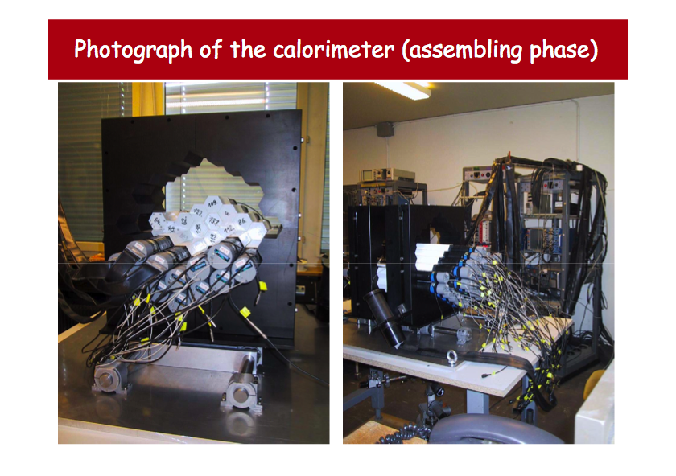
ETH-INR experiment on o-Ps -> nothing

Slide 27
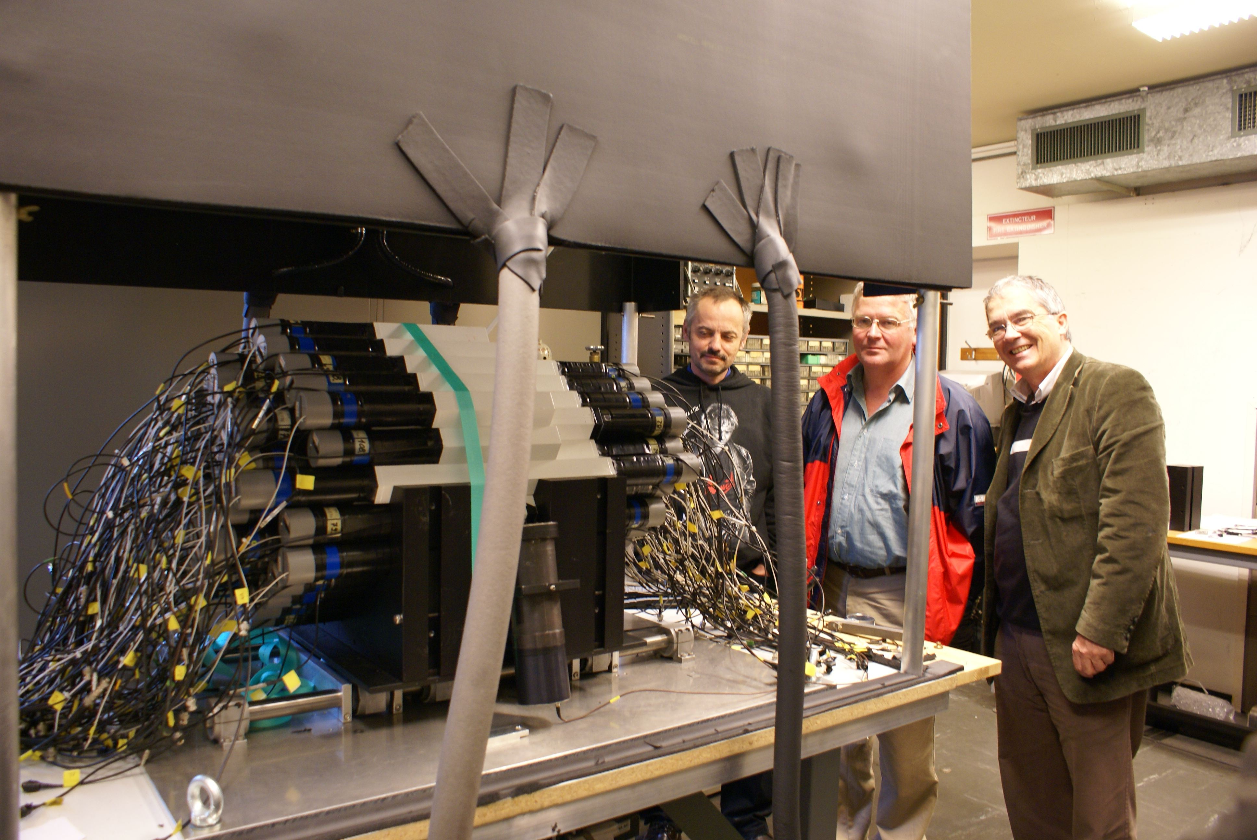
Фото 2

Slide 28
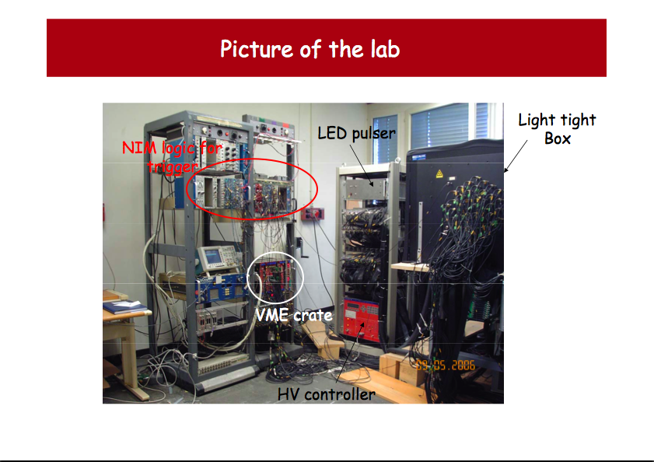
ETH – INR Experiment

Slide 29
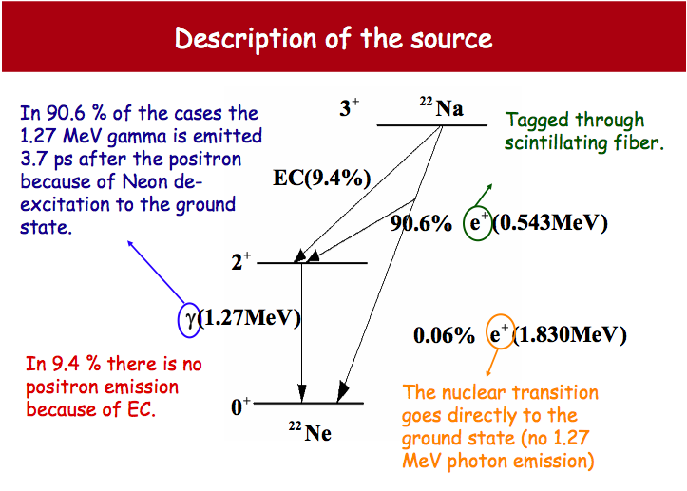
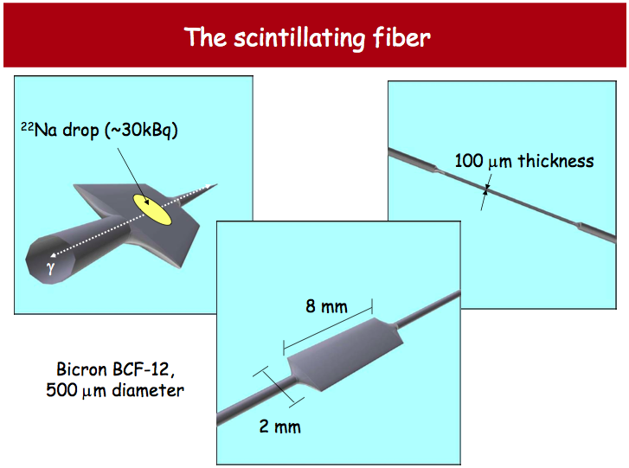
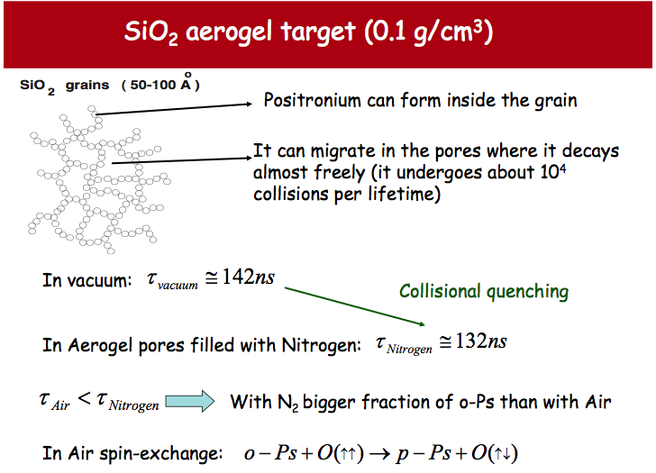
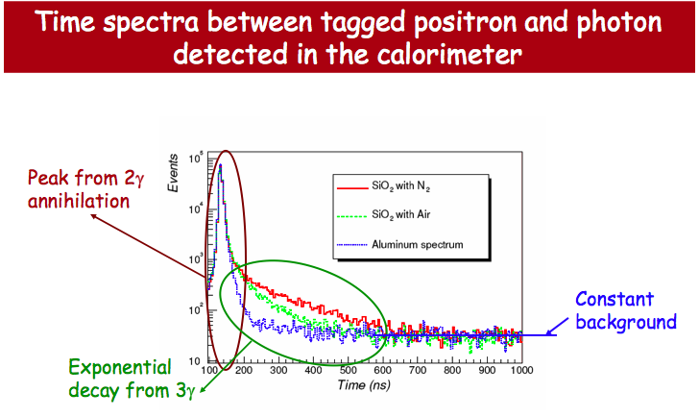
Components

Slide 30
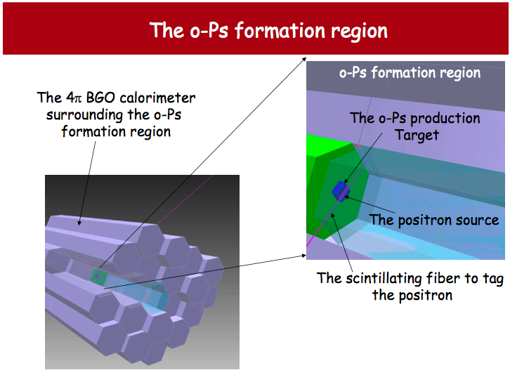

Slide 31
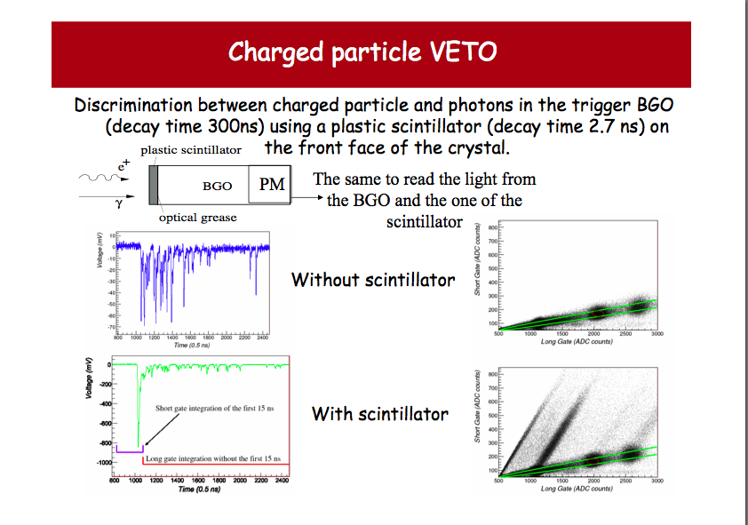
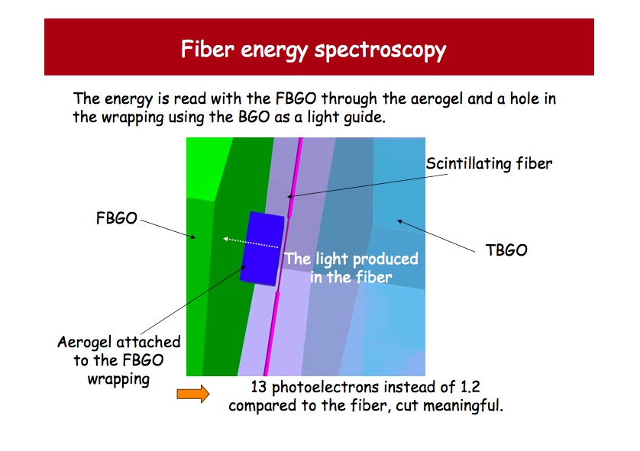
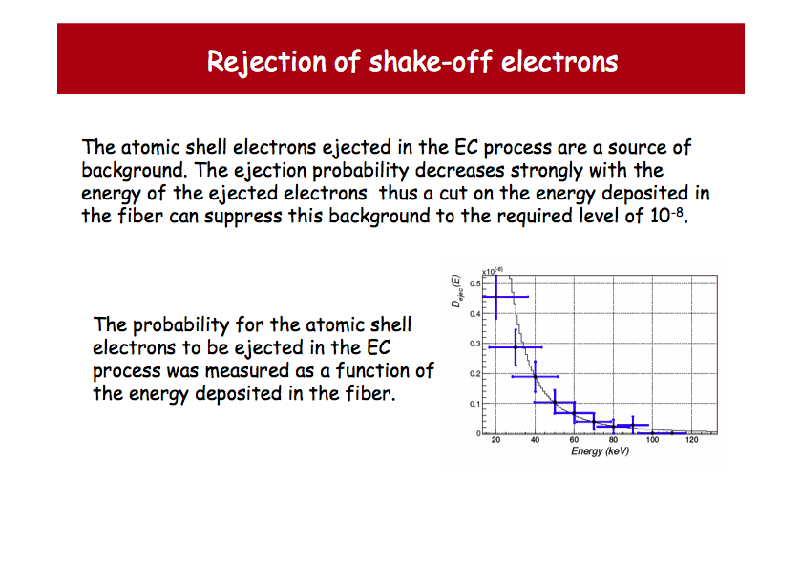
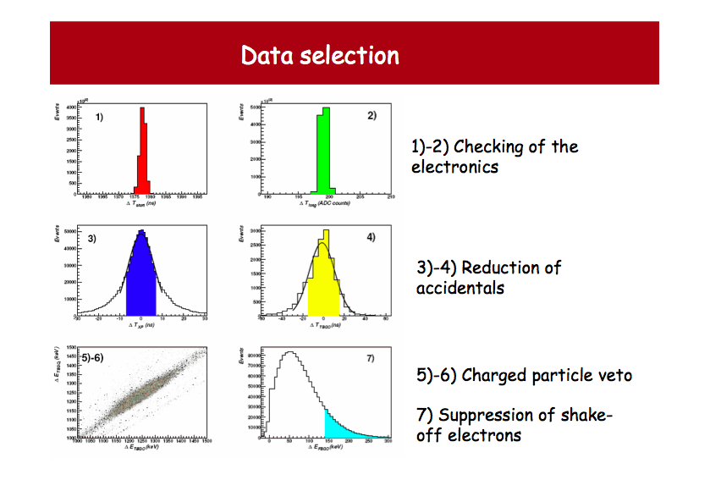
Improvements

Slide 32
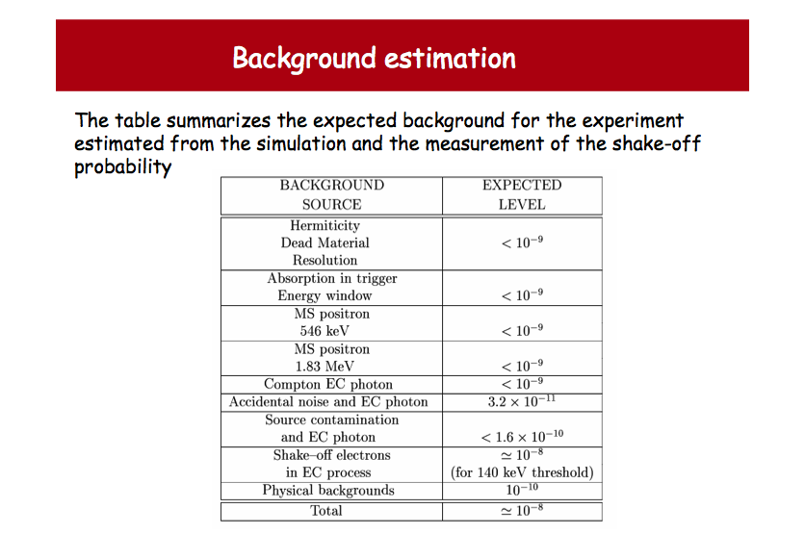
Most dangerous!

Slide 33
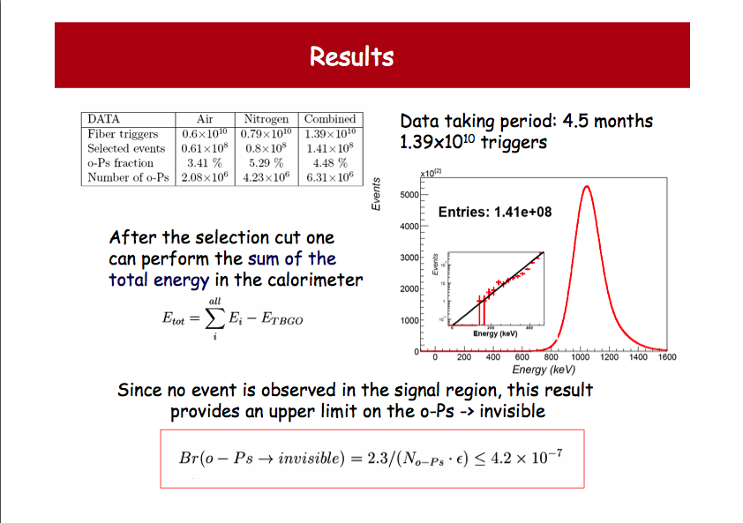
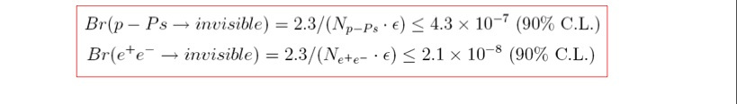
A.Baderscher et al., PRD(2007)
80 keV
factor ~7 better
than Tokyo

Slide 34
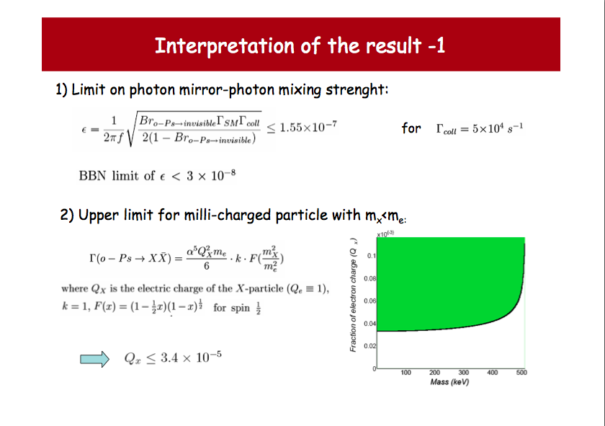
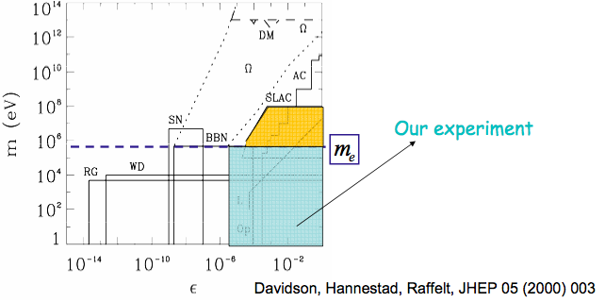

Slide 35
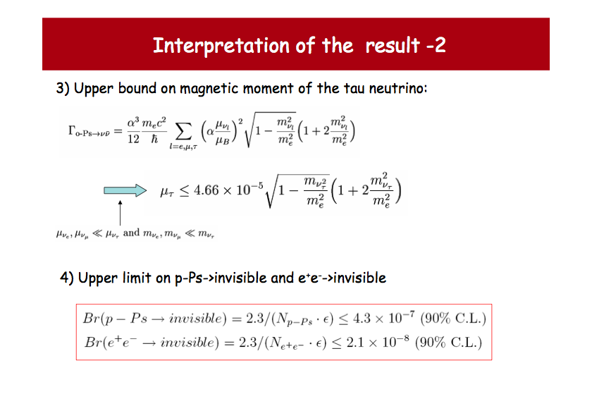

Slide 36
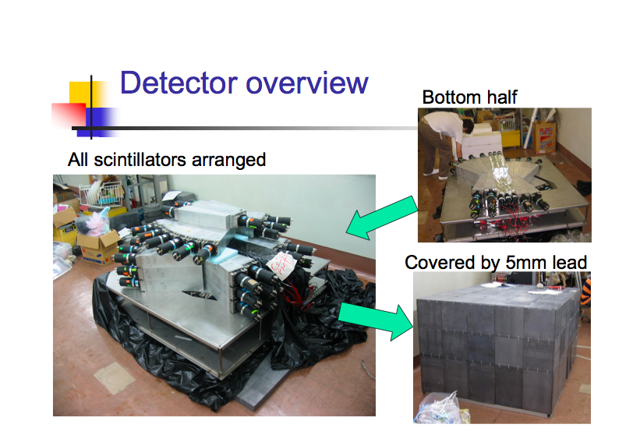
New Tokyo experiment on o-Ps -> invisible

Slide 37
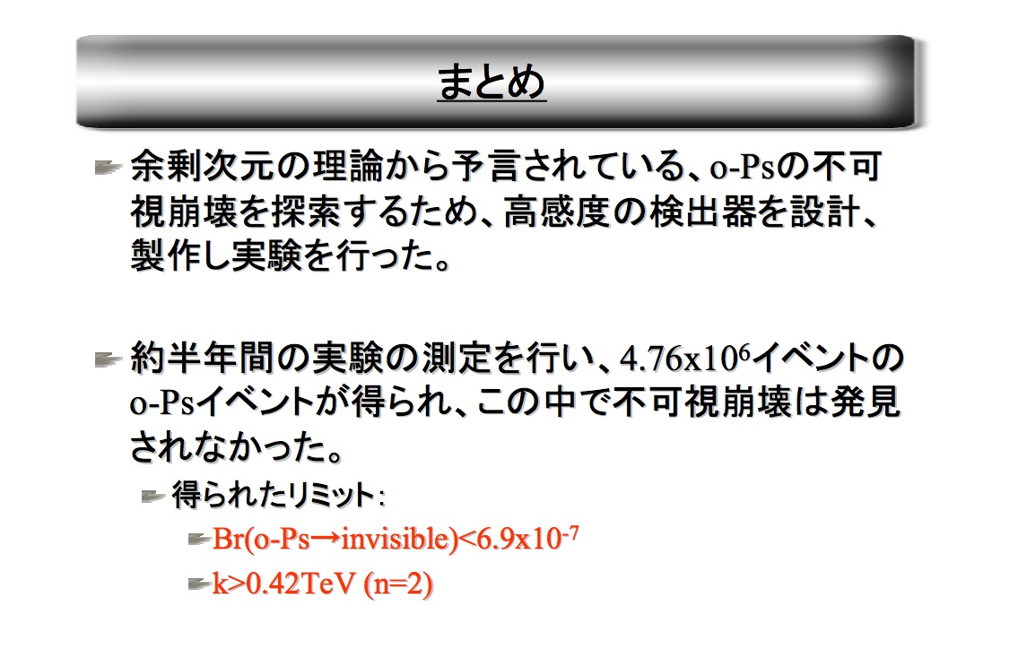
Tokyo results`08 on o-Ps -> invisible
(Not published)

Slide 38
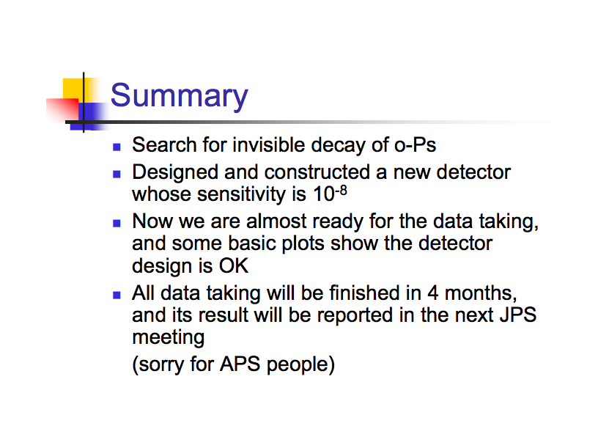

Slide 39
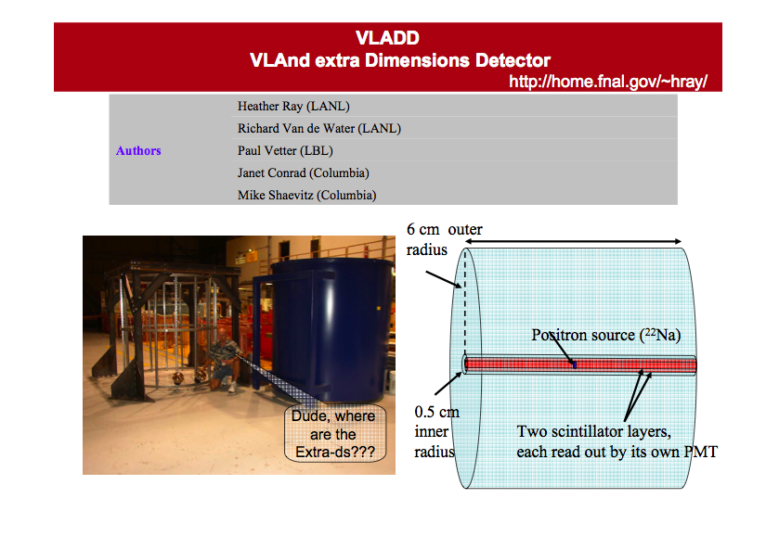
VLADD
Goal: Br(oPs->nothing) ~10⁻⁹

Slide 40
o-Ps -> nothing: Past &Future
INR, Atoyan et al.1989
10 ⁻⁴
Glashow, 1989
Excluded by BBN
10 ⁻⁵
Mitsui et al. 1993
10 ⁻⁶
ETH -INR 2007
10 ⁻⁷
Milicharged particles,
Mirror Dark Matter
Branching ratio (o-Ps -> “invisible”)
10 ⁻⁸
LBNL/LLNL 1st design proposal
Limit from width of (Z⁰ -> invisible)
10 ⁻⁹
Allowed region for (o-Ps->γ->extra dimensions)
10 ⁻¹⁰
Triviality:
extra dimension physics
happens at > 10 TeV
Neutrino
magnetic moment
10 ⁻¹⁸
(o-Ps -> νν)
P. Vetter
LBNL, 2006

Slide 41
Поиск темной материи
в распадах позитрония

Slide 42
P violation: two classes of models
Great mistery: why only left-handed fermions feel week interactions?
Wu et al.’56: decays of polarized ⁶⁰Co-> ⁶⁰Ni e- ν.
Left-right symmetric models-
Parity restoration at high energy scale > 1 TeV,
New heavy right handed W_{R}
LHC can probe W_{R} mass up to 3 TeV, (N.V.Krasnikov, this Workshop)
however, already high limits on M(W_{R}):
> 2.5 TeV from ΔM_{K/B} and
> 4 TeV from K0-decays (R.Mohapatra,X.Ji, this Workshop)
Mirror matter model -
So far no data confronting the model
Effects of parity restoration can be directly observed
at low energies in a table top experiment (a’la Wu)

Slide 43

Left-Right (Mirror) Symmetry
Our World
Mirror World
left corkscrew
right corkscrew
right corkscrew
Is Parity conserved?
To be probed experimentally!

Slide 44
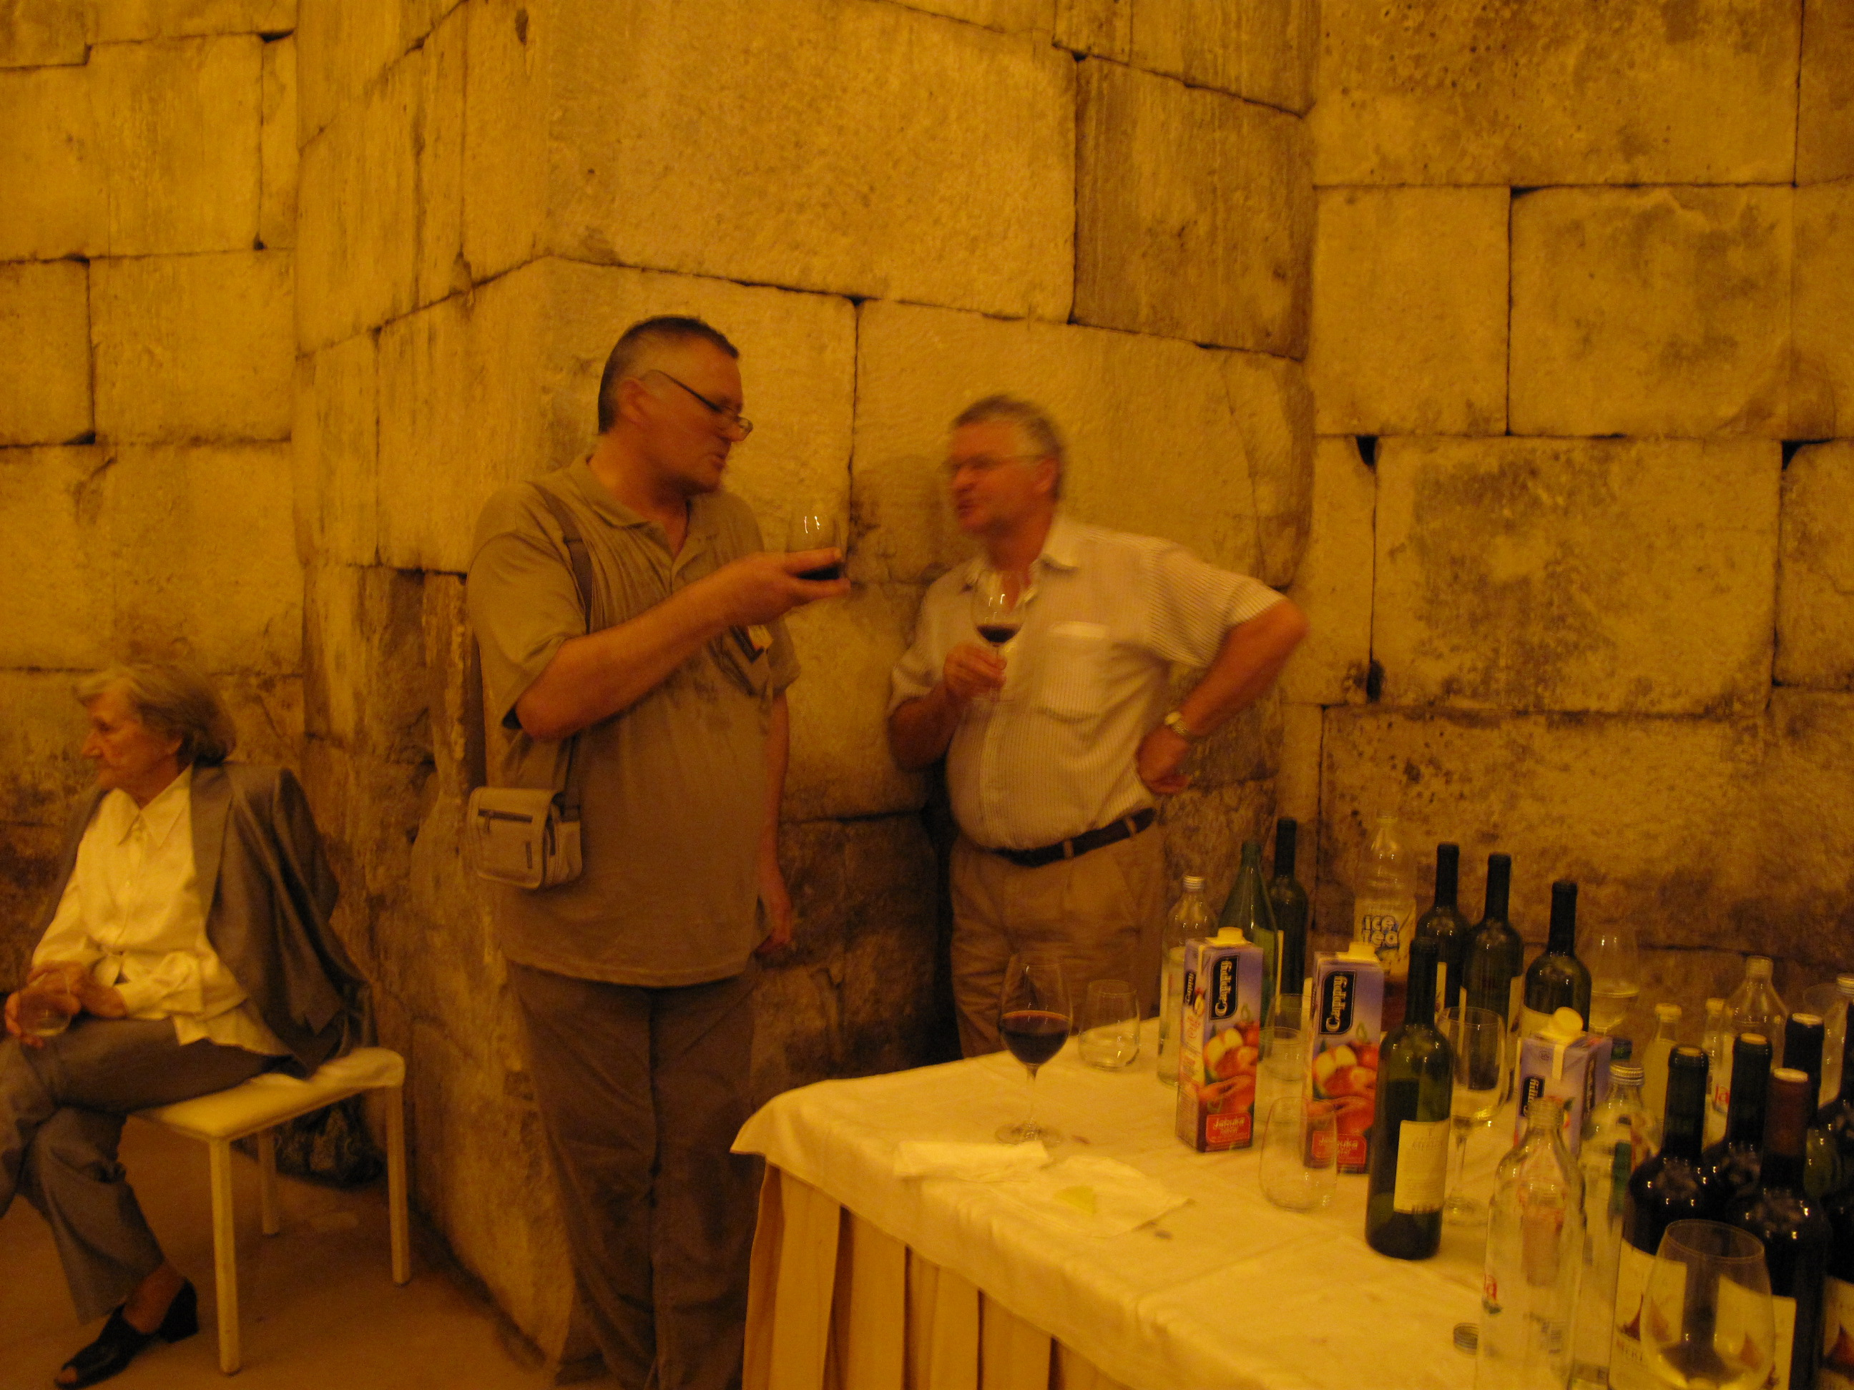
...we need
more
measurements…
Our World
Mirror World
Notes:
44

Slide 45
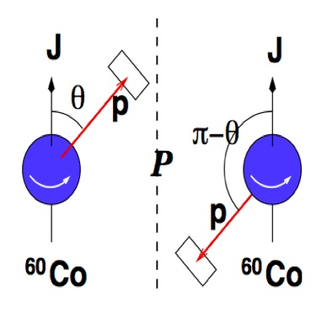
Parity Violation
P mirror
Experiment: I(Θ)dΘ=C(1+α cosΘ)sinΘdΘ !

Slide 46
CP invariance
CP mirror
C
-
Our world and CP-world are the same: e- -> e+, p -> p, …
Experiment: CP violation in K meson decays !

Slide 47
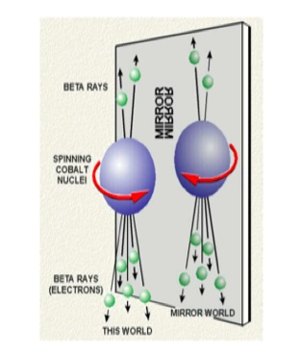
Hidden (Mirror) World
CPA mirror
Our world and CPA-world are not the same: e- -> e’,…
Must be hidden!

Slide 48
Mirror Matter Model/ Hidden Valely@LHC
old idea: P -> CP -> CPA symmetry
Nature is intrinsically L-R symmetric with L-R particle
properties exchanged: V-A->V+A
New CPA-sector must be hidden; connected to our world by gravity
Kobzarev, Okun, Pomeranchuk’65; Lee, Yang’56; Pavsic’74;
Blinnikov, Khlopov’83.
Modern MMM is based on minimal symmetry:
(SU(3)_{C} x SU(2)_{L} x U(1)_{Y}) x (SU(3)_{CM} x SU(2)_{R} x U(1)_{YM})
SM fermions and gauge bosons are accompanied
by identical mirror partners. MM is a good candidate for DM,
can be linked to string theory, extra dimensins.
no data confronting the model
Ordinary-Mirror particles renormalizible interactions
- mixing of Higgs
- kinetic mixing of photons
Foot, Volkas’91 Berezhiani, Mohapatra’95, Berezhiani et al.’00-08,
.For review see: L.Okun hep-ph/0606202

Slide 49
Оrdinary -mirror particle interaction
Conservation laws for ordinary matter and mirror matter prevent particles with colour and charge from interacting between two sectors.
+
+’
But, interaction between colourless neutral particles is allowed: ordinary and hidden sectors can communicate trough
mixing of H-H`, kinetic mixing of photons, mass mixing
between neutrinos, neutrons, etc…(Z.Berezhiani, this Workshop)

Slide 50
How our and hidden world could communicate?
through gravity
through photon-hidden photon mixing
through mixing of Higgs particles
and , in principle, through mixing of other particles
What are the observational consequenses?

Slide 51
Possible MM effects:
Higgs mixing (LHC)
Ignatiev, Volkas ’01; Barbieri et al. ‘05,
Wilczek’ 07, Li et al. ‘07…..
Ps-Ps` oscillations
Glashow ‘86, SG ‘95,
Foot, SG ’01; Atoyan et al. ‘89,
Mitsui et al. ‘95, Badertsher et al. 07
n-n` mixing (PSI)
Berezhiani, Bento ‘05; Pokotilovski ‘06,
Ben et al.(PSI) ‘07, Serebrov et al.
(PNPI) ‘07, Mohapatra et al. ‘05.
dark matter(Gr.Sasso)
DAMA ’05; DAMA/LIBRA ‘07,
Foot ‘01-07; Ignatiev,Volkas’03,
Mitra’03-06,…
ν-ν` mixing
Berezhiani, Mohapatra ‘95, Foot, Volkas ’00; Mohapatra, Nasri ‘05
cosmology
Blinnikov, Khlopov’82,83, Khlopov’91,00, Berezhiani’95-08, Ciarcelluti’03-05,….
millicharged part. (SLAC,DESY)
Holdom ’85; Ignatiev ‘91; Gninenko et al.’07….
anomalous events, ……
Foot, Silagadze’01-05, Foot,Mitra’02-03,…

Slide 52


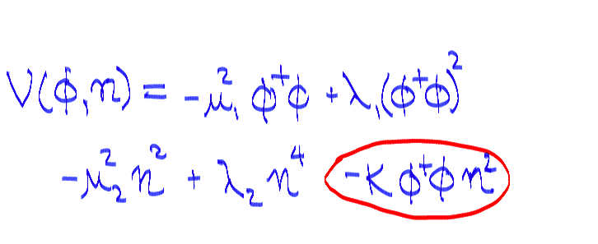
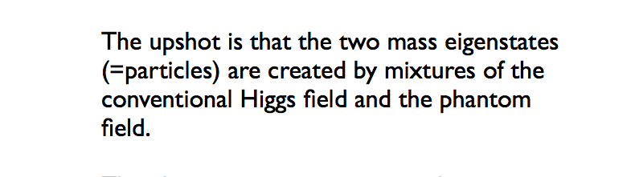
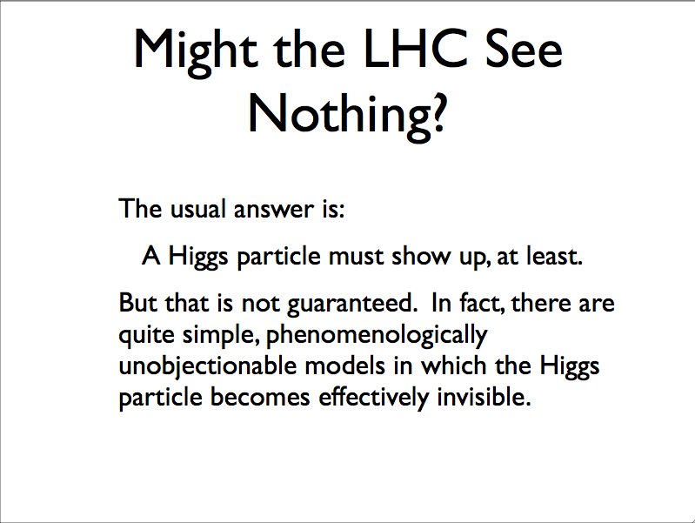
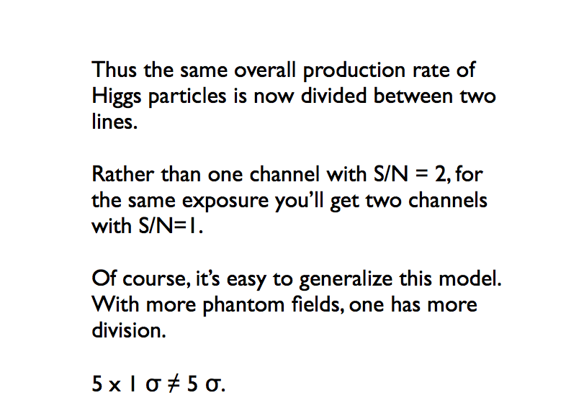
Mirror Matter at LHC (F. Wilczek`s Colloqium at CERN)
Frank Wilczek
CERN Colloqium
May 3 2007

Slide 53
Search for neutron-mirror neutron ocsillations
Z. Berezhiani and L.Bento, PRL 96(2006) 081801
the small mass mixing between the ordinary neutron n and its mirror partner n' could have direct astrophysical consequences, in particular, for the propagation of ultra-high energy cosmic rays at cosmological distances The experimental possibilities to test the n-n' oscillation were discussed by Yu.N. Pokotilovski PL B639(2006)214
PSI (2007)
A Direct experimental limit on neutron-mirror neutron oscillations.
G. Ban et al. arXiv:0705.2336 [nucl-ex]
PNPI (2007)
Experimental search for neutron-mirror neutron oscillations using storage of ultracold neutrons.
A.P. Serebrov et al.arXiv:0706.3600 [nucl-ex]

Slide 54
Effects from γ-γ` kinetic mixing
εF^{μν} F`_{μν}
γ
γ`
γ-γ` oscillations (if γ` not massless) Okun’82
millicharged particles: q=2εe Holdom’86
oPs - oPs` oscillations Glashow’86, Foot,S.G.‘2000
mirror matter scattering off our matter Foot’04-08

Slide 55
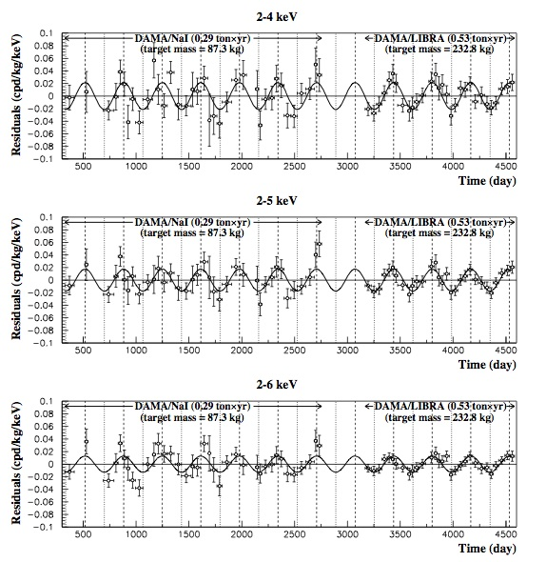
DAMA/LIBRA effect
Dark matter signal annual modulation?
~250 kg NaI(Tl),
0.53 ton x y
Signal in 2-6 keV region
S=Acos(2π(t-t₀)/T)
A=(0.013+-0.0016) cpd/kg/keV
significance 8 sigma
T/y=0.998+-.003
t₀ /day=144+-8
If Dark matter:
T/y=1.0, t₀ /day=152.5
R. Bernabei et al.
Eur.Phys.J.C56:333-355,2008.
e-Print: arXiv:0804.2741 [astro-ph]

Slide 56
DAMA/LIBRA: Mirror Dark Matter scattering?
A`, Z`
DAMA/LIBRA NaI(Tl)
A`, Z`
If mirror matter is identified
with the nonbaryonic DM -
mirror atoms could be a large component of galactic DM halo
A, Z
E_{R} -recoil energy
Counting rate due to γ-γ`interaction :
dR/dE_{R} ~ ε²n`/(vE_{R} )²
v - Earth velocity around
the Sun is modulated
170 km/s < v < 270 km/s
n` - halo number density for
A` = H`, He`, O`, etc.
Prediction: ε~ 10⁻⁹
R. Foot, PRD 78(2008)043529

Slide 57
Mixing strength ε~ 10⁻⁹
Consistent with BBN ε<3 10⁻⁸ and all experimental limits
Consistent with null results of
CDMS/Ge
CDMS/Si
XENON10
due to lower DAMA energy threshold and lighter target
Other WIMP interpretations : are they disfavoured ?
How to check DAMA/LIBRA Mirror DM interpretation?
-Directly: Massive ~ 1 ton, low Z detector with a low ~ 1 keV recoil energy threshold - very challenging task.
-Indirectly: oPs-oPs` oscilaltions

Slide 58
Orthopositronium oscillations
Glashow ‘86; SG`91; Foot and SG`00
εF^{μν} F`_{μν}
e-
e’-
oPs+
γ`
oPs
γ
∆E=2εf
e’+
oPs`
e+
oPs-
oPs
oPs`
new mass eigenstates: oPs± = (oPs±oPs`)/√2
energy splitting: ∆E=2εf, f=8.4x10⁴ MHz from oPs-pPs splitting
oscillation probability: P(oPs-oPs`)(t)=sin²(2πεft)

Slide 59
Experimental signatures for oPs-oPs’ oscillations
modification of oPs decay curve -
very difficult to measure, high statistics required
oPs->oPs`-> 3γ’ -> invisible decay -
more convinient: few events need to be observed
Branchnig ratio in vacuum:
in a target (in presence of collisions):
SG’95, Foot and SG ’00
Suppression factor

Slide 60
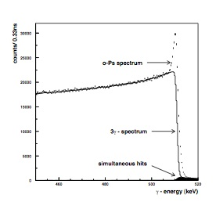
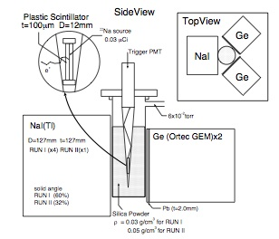
Tokyo experiment with silica target
511-keV line
from 2γ annihilation
Γ_{oPs} = Γ_{exp} - Γ_{pick-off}
Ge
Experimental setup
spectrum from Ge detector
oPs formation and decay in a 0.1 g/cm³ dense target
~10⁴ collisions/lifetime results in pick off rate:
e+e- + (e-M)-> e- + (e+e- -> 2γ)+ M ~10⁻² Γ_{oPs}
Asai et al.’08

Slide 61
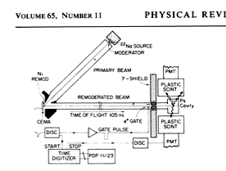



Ann Arbor Paradox: but no 511 keV line?!
Ge
no 511-keV line !

Slide 62

Limits on ε
DAMA/LIBRA, ε~10⁻⁹
Excluded by BBN ε<3x10⁻⁸
Excluded by oPs-> inv, ε<3x10⁻⁷
Vacuum experiment with a sensitivity in Br(oPs->inv)~10⁻⁸
would be very important to check DAMA/LIBRA and BBN

Slide 63

Notes:
63

Slide 64

Поиск темной материи
Ps
Ps*
Notes:
64

Slide 65

How to search for hidden world with oPs?
Cortesy New Scientists, 2004.

Slide 66


Search for mirror dark matter via o-Ps->invisible
“An apparatus to search for mirror dark matter via the invisible decay of orthopositronium in vacuum,”
A. Badertscher et al. hep-ex/0311031
e+ tagging system: timing
coincidence of e+ bunch and
MCP signal from secondar electron
emission , inefficiency < 1.e-8
pulsed slow positron beam,
high efficiency & compression
factor
cold oPs to minimize leak through
entrance window
hermetic calorimeter in magnetic field
very thin vacuum pipe

Slide 67


Cross-check of oPs disappearance
No Coherence due to collisional
quenching of oPs-oPs`transitions
Coherent oPs-oPs`transitions
Different from the LEPTA approach to search for modulations of
the o-Ps decay curve, e.g. I.N. Meshkov et al. NIM B214 (2004) 186
Comparison of two independent experiments would be very
Intersting and important!

Slide 68
Пульсирующий пучок, система мечения,
и вакуумная мишень позитронов

Slide 69

Double Gap Buncher

Slide 70

Positron moderation
e⁺s strike a W single
crystal foil
Slow to epithermal
energies in ~10^{–12} s
Diffuse ~ 500 nm.
Either annihilate, or
Escape through a
surface with E ~3 eV.
Efficiency ~10 ^{– 4}
Difficulties:
annealing at 2000 C to
remove deffects
UHV for lifetime of the
surface
http://positron.physik.uni-halle.de

Slide 71
How to make pulsed beam?
E
Departure:
small ΔE, but large Δt
Arrival time
Positron velocity modulation:
accelerate those who are late
t
ΔE
E
Arrival
small Δt, but large ΔE
t
E
Problems for large Δt
- fast switch on-off of high voltage
possible aberrations
intensity is limited by rad. safety
Δt
t

Slide 72



Pulsing System
Low aberration scheme
Double gap buncher
Pulse shape

Slide 73


Slide 74

Фото пучка (+топ модель)

Slide 75




Beam Photos

Slide 76


Results on positron pulse width
Alberola et al., Nucl. Instr. Method A 560 (2006) 224-232
~ 2.3 ns (FWHM)
for an Initial pulse of 300ns
~1.4 ns (FWHM)
for an initial pulse of 120ns
Compression factor 100!
5 times better than reported previously by two groups in Japan
Repetition period ~ 1 μs
Tokyo Univ. group, H. Iijima et al.
NIM A483 (2002) 641: Compression of
~ 60 ns
~ 2 ns (FWHM)

Slide 77

e+ bunch shape vs V(mod): FWHM from 1.4 ns to 0.6 ns
Spectra of moderated e+ before and after annealing at ~2000 C: improved monochromaticity and e+ yield

Slide 78



positron tagging system
expected inefficency < 10⁻⁸, Δt=start-stop~ 10⁻⁹ sec
positron bunch, stop signal
cold oPs formation
ExB region I
ExB region II
e+
MCP, start signal
secondary e-’s

Slide 79



Cold Ps formation target
~1µm
Ps formation in porous Si films
to minimize the leak.
Could be crutial for Hbar formation!

Slide 80
Измерение свободного гравитационного
падения антиводорода

Slide 81

Гравитация или…Антигравитация?

Slide 82
Antihydrogen study at CERN: AEGIS
Initial State
Final State
PS proton beam, 26 GeV
Free falling
antihydrogen
?
g
e+ source Na-22, 0.5 MeV
CPT in Hbar
free gravity fall of Hbar
Ps physics
goals

Slide 83


Свободное падение Антиводорода: AEGIS
Анти-водород
PS proton beam, 26 GeV
=
g?
e+ source Na-22, 0.5 MeV

Slide 84

AEGIS@CERN

Slide 85
Hbar formation: Why cold Ps ?
Rydberg State Ps
antihydrogen production rate:
R = N(p) n(Ps) σ(p+Ps*->Hbar) L ε Ω
Ps density: n(Ps)=N(Ps)]/Vol
n(Ps) ~ 1/Vol ~ (1/L)³ ~ (1/v_{Ps})³
~ (1/T)^{3/2}
for charge exchange σ(p+Ps*->H) is enhanced
if v_{Ps}=(3kT/m_{Ps})^{1/2} < α c/2n_{R} (velocity in Rydberg state n)
for n_{R} ~ 40 v_{Ps} ~25 km/s and T ~10 K
Can we create and manipulate cold Ps’s in a vacuum
under controlled conditions?
Pbar
Ps
Hbar
L
Laser beam
Workshop on Antihydrogen Formation, July 14,2006 CERN S.N.Gninenko/INR

Slide 86
Формирование холодного aнтиводорода
p + Ps(e+ e-) -> H(pe+) + e-
мишень
p
H
Ps
холодные
анти–протоны
антиводород
Q`s:
how to check Rydberg n?
Ps laser cooling?(complicated)
Ps thermalization time?
- B field?
Cold Rydberg State Ps
Ps Temperature < 10 K
e+
σ(pbar+ Ps* ->Hbar)~ ~ n_{R}³
v_{Ps}=(3kT/m_{Ps})^{1/2} < α c/2n_{R}
позитроны

Slide 87



Cold Ps: TOF-study of yield and temperature
e+’s stop, thermalized, form o-Ps
o-Ps yield:~30-40% emitted into vacuum
mean free path ~ 3 nm,
diffusion length L>> film
thickness
number of collisions with pore walls 10⁴ – 10⁶ (depending on implantation depth/energy)
well thermalized E(o-Ps) ~ kT
thermalization time t~R/V n
t~1 ns << t (o-Ps)
E = 40 meV, V=1.2 10⁷ cm/s,
R ~ 1 cm/lifetime

Slide 88
Диагностика Наноструктурных
Материалов. Новый PALS спектрометр
на вторичной электронной эмиссии.
(How to make money out of theory like QED!?)

Slide 89
Materials science forum, ICPA-13, JAPAN
``There is no doubt that, when it comes to
the study of the structures and defects of nano-materials,
there is presently no technique that rivals positron
annihilation…`` T. Hyodo
Slow positron beam application to: Polymers, Drug-delivery and Cancer
Researches
PAS study of Radiation ebrittlement of Nuclear Reactor Steels
Slow positron study of corrosion defects in Metallurgy iron and
Al alloy.
Application of PAS technique for monitoring of Semiconductors
Pulse slow-positron beam for Polymer films
PAS for nanocavities and nanoclusters in Si
Durability of polymeric coatings for Aircraft Industry
Application of PAS for biological objects
…………
Energy Storage
POSITRON Bomb
Simposium on Production and Storage
of Macro-quantities of e+`s (US Air Force)

Slide 90





Defect types and sizes
Atomic vacancies, 0.1 nm
Dislocations, 1 nm -10 mkm
Voids, 0.1 nm - 1 mkm
Holes, 0.1 nm - 10 mkm
Cracks, 0.1 - 10 mkm

Slide 91

PAS: unique tools for Defect Characterization in Material Researches

Slide 92

Comparison of Different Techniques for ID of Defects
Scanning tunneling/Atomic Force Microscope
Transmission electron Microscope
Neutron Scattering
X-ray/Synchrotron Radiation
Optical Microscope
Semiconductor Chips
Industry

Slide 93

Comparison of Different Techniques for ID of Atomic Defects

Slide 94

Facilities and Labs
for Positrons Nanoscience and Technology
USA: 25
Japan: 10
EU: 30
Washington Center of Material Researches, USA
EPOS , Research Center , Rossendorf, Germany
National Inst. of Advanced Industrial Science and Technology, Japan
e.g. no PALS beam in France, Switzerland, . . .

Slide 95


Slide 96


Slide 97


Slide 98
Russia
Отсутствуют пучки медленных позитронов,
сильная школа “позитронщиков“.
ИФX
ИТЭФ
ФИАН
ОИЯИ ( LEPTA)

Slide 99




Positron Annihilation Lifetime Spectroscopy(PALS)
Measures positronium (Ps) annihilation lifetimes and intensities, which can be related to the size and amount of defect structures, such as voids or pores in the range of several angstroms to tens of nanometers. Suitable for insulating materials while not good in the bulk of metals since Ps cannot be formed in the latter.
Measures positronium (Ps) annihilation lifetimes and intensities, which can be related to the size and amount of defect structures, such as voids or pores in the range of several angstroms to tens of nanometers. Suitable for insulating materials while not good in the bulk of metals since Ps cannot be formed in the latter.
Measures positronium (Ps) annihilation lifetimes and intensities, which can be related to the size and amount of defect structures, such as voids or pores in the range of several angstroms to tens of nanometers. Suitable for insulating materials while not good in the bulk of metals since Ps cannot be formed in the latter.
Measures positronium (Ps) annihilation lifetimes and intensities, which can be related to the size and amount of defect structures, such as voids or pores in the range of several angstroms to tens of nanometers. Suitable for insulating materials while not good in the bulk of metals since Ps cannot be formed in the latter.
Measures positronium (Ps) annihilation lifetimes and intensities, which can be related to the size and amount of defect structures, such as voids or pores in the range of several angstroms to tens of nanometers. Suitable for insulating materials while not good in the bulk of metals since Ps cannot be formed in the latter.
Main Experimental Problems :
Time resolution < 0.5ns
resolution function shape
peak/background > 1.e3
wide range of lifetimes
from 0.3 to 100 ns

Slide 101

Схема измерений

Slide 102
Проблема
как измерять очень тонкие (100-1000 Å)
образцы нано–материалов?
Позитроны от радиоактивного
источника обладают слишком высокой энергией, Ē >200 кэВ, проходят через образец и не формируют позитроний

Slide 103


Beam PALS : Depth Profiling of defects
The major advantage of e+ beams is ability to control positron implantation depth by varying the beam energy
Critical feature for analysis of surfaces and thin films
Mokhov`s Implantation Profiles

Slide 104



PALS technique 1: Pulsed slow-positron beam
START: pulsing electronics, STOP: annihilation gammas
Osaka Univ., 2002
ETH-INR, 2006-2007
30 ns ->1.4 ns
90 ns -> 0.7 ns
width better ~ 2
Compression ~ 3
Peak/background ~10

Slide 105


PALS technique 2: Secondary Electron Emission Detector
START: secondary electrons, STOP: annihilation gammas
BaF₂
Simulation of SEED extraction optics:
Slow Positrons ~200 eV
Acceleration Electrode
1-20 kV
Sample
Deflection Plates
MCP (START SIGNAL)
Secondary electrons
Annihilation photons (STOP SIGNAL)

Slide 106


Application to Nanoporous films
The International Roadmap for the Next Generation of Microelectronics
Today’s Microelectronics needs:
-smaller and faster devices ,
-reduction of transistor gate delays.
The signal propagation delay:
- RC delay , R interconnect resistance
- C interlayer dielectric capacitance
Industry: replacement traditional SiO2 dielectrics(k=4)
with lower-dielectric constant (low-k) materials
Candidates for k=2.0-3.5:
- organic and inorganic polymers,
- nanoporous SiO2, etc.
Large pores will be necessary to go down to k~1.0 (air)porosimetry

Slide 107
First Results with SEED
on nanoporous low - k dielectrics films from Microelectronics:
thickness and structure of the internal layer are difficult to probe
~1000 Å thick
capping layer
~300Å
е+
Typical
spectra
r~10 Å
k~2.7
3 keV
1 keV
Pore size distribution
PALS spectra at different energies

Slide 108
Comparison of PALS spectra
Washington Center of Materials Researches (Prof.K.Lynn,Lab)
Kapton ~400 ps
dense
porous
Low-k Si : ~40 ns
Excellent agreement for wide range of positron lifetimes

Slide 109
PALS spectra for degraded polymeric coating
e+
Polymeric
coating ~400 ps
e+
e+

Slide 110


Экспериментальный комплекс для позитронных исследований
e+
Positron beam

Slide 111


Linac Technologies (FRANCE)
Small Industrial Linac
~10 MeV, ~ 2 mA, ~10 kW
pulse mode: 1 – 4 mks, 200 Hz
intensity: ~ 5 10¹¹ fast e+/s
flux: ~ 3 10⁷ slow e+/s, eff.~10⁻⁴
cost ~ 300 kEuro

Slide 112


Slide 113
SUMMARY
New Multidisciplinary Research Direction on Positron and Ps Physics, including
precision tests of the SM and searches for New Physics beyond the SM
developing of new experimental techniques for fundamental and applied researches
use of developed techniques as an unique tool for Material Researches, in
particular for characterizations of nanomaterials and for Industrial Applications
Phenomenology:
millicharged particles
new light bosons
extra dimensions
mirror type matter
C, CP, CPT tests
New Experimental Techniques:
high efficiency slow positron beam
secondary electron emission
lifetime spectrometer
cold Ps formation
Simulations: SIMION, 3d-B, Geant 4
Experiments:
precision measurements with oPs
searches for exotic Ps decays
search for hidden sectors
( extra D, mirror type matter),
best limit on oPs->nothing
Hbar gravity fall
Nanoscience and Technology
low-k dielectric nanoporous films
for 3d generation of microelectronics
surface defects and coatings
free volumes in polymers
defects in semiconductors, ……
Analysis tools: PALFIT, MELT, LT, …

Slide 114
Backup Slides

Slide 115


o-Ps -> gamma + X decay
S.G.,Krasnikov(preliminary)

Slide 116
LEPTA approach
The purpose of the project LEPTA (Low Energy Particle Toroidal Accumulator) is to create in the JINR new
basic installation for investigations in the field of positronium physics.
The precision measurement of the ortho- and parapositronium characteristics is one of the fundamental
problems of the modern quantum electrodynamics. With positronium fluxes in vacuum one can to perform new
original setting up the experiments without the distortion caused by medium in the traditional methods of the positronium
generation in a target. The accuracy of the measurement of the positronium life time, the probability of decays with
momentum conservation and charge invariant infringement (CPT violation), fine structure of the positronium spectrum,
Lamb shift measurements can be much higher than in traditional methods.
So, in the positronium physics the following problems can be addressed as important subjects for experimental studies:
- the positronium life time (in ortho- and para-states),
- search for hypothetical short-lived bosons,
- the hypotheses of so called "mirror universe",
- the parameters of the positronium atomic structure,
- the comparison of electron and positron electric charges, measuring a deflection of positronium in strong magnetic field.
The experiments with antihydrogen-in-flight can be performed by comparison of antihydrogen and hydrogen atoms
characteristics under the same conditions. This brings great advantage for high precision and high-resolution measurements.
Among these experiments the most promising are the following: - the comparison of antiproton and positron electric charges,
measuring a deflection of antihydrogen in strong magnetic field; repeating the same for hydrogen and using very precise knowledge
of electron and positron charge values, one can "close the chain" for all 4 particles and compare also
proton/antiproton masses, using very precise knowledge of their charge to mass ratio,
- microwave spectroscopy of antihydrogen;
- laser spectroscopy of antihydrogen;
comparison of antiproton and proton magnetic moments from data of antihydrogen spectroscopy.
The design of the storage ring and elaboration of the technology of the magnetic system manufacturing were performed
under support of the RFBR (project “Creation of low energy positron storage ring and positronium fluxes generation”,
grant N96-02-17211) and Fermilab, USA (Accord on Modified Betatron Prototype).
The works in the frame of the project are supported by RFBR (project “Positronium flux generator”) and INTAS
(“Generation and experimental studies of antihydrogen and positronium in-flight”, grant N96-0966) and are provided
in collaboration with Institut fur Kernphysics, Juelich, Germany, University College London, UK and ITEP, Moscow.
Electron cooling, control and diagnostics systems are created on the base of the Test Bench of the LNP JINR.
The vacuum chamber of the ring has to be constructed in INOE-2000, Magurele, Romania, in the frame of the Romanian p
ayment to JINR budget.

Slide 117

Testing CPT in Ps Annihilation
Polarized O-Ps has a distribution of decay planes with respect to .
T-even
T-odd
Search for a cos(θ) distribution of decay planes with respect to spin
Determine polarization from cos² (θ) distribution of decay planes
Previous Results on this signature:
B.K. Arbic et al., Phys. Rev. A 37,3189(1988).
S.K. Andrukhovich et al., Inst. and Exp. Techniques 43, 453 (2000).
Factor of 10 improvement
with Gammasphere
LBNL Gammasphere Result
C_{n} = -0.0026(31)
P.A. Vetter and S.J. Freedman, PRL 91, 263401 (2003).

Slide 118
Methods of Positron Annihilation Spectroscopy (PAS)
When positron stops in a matter it finally annihilates with an electron
into photons
What one can measure?:
Time of photons emission relative to positron injection time to
the target (PALS - positron annihilation lifetime spectroscopy)
Angular correlations between emitted photons (ACAR - angular correlatiuon of annihilation radiation)
Energy spread of emitted photons (DB-Doppler broadenning)

Slide 119
o-Ps decay rate puzzle (1982-2002)
History of oPs decay rate measurements
Discrepancy :
unknow contribution at the level
Br(oPs->X)~10⁻³ or
- experimental problems
Ann Arbor “big” cavity
Tokyo measurements (oPs formation in target) and
Ann Arbor experiment (oPs formation in vacuum,)
agree to each other and also agree with QED predictions
Ann Arbor “small” cavity

Slide 120

o-Ps decay rate puzzle (1980-2000)
Discrepancy beween measured and predicted oPs dacay rate in vacuum
Review: Dobroliubov, Gninenko, Ignatiev, Matveev, IJMP А8 (1993) 2859
- systematics ?
- QED rate is not reliably calculated ?
- new physics ?
B calculated
G. Adkins et al., 2000
~10 sigma discrepancy unknown B
Today: agreement within 1sigma, but theoretical accuracy is a factor 100 better!

Slide 121

Experimental setup for Hbar gravity fall
Detector
Cold Rydberg State Ps
Ps Temperature < 10 K
Pbar
Hbar beam
Ps*
Interferometer
Laser beam
Q`s:
how to check Rydberg n?
Ps laser cooling? (too complicated)
Ps thermalization time?
- B field?
σ(pbar+ Ps* ->Hbar)~ ³
n_{R}
v_{Ps}=(3kT/m_{Ps})^{1/2} < α c/2n_{R}
Workshop on Antihydrogen Formation, July 14,2006 CERN S.N.Gninenko/INR

